Slide 1
Parapsychology & the Nature of Abilities
Stephen E. Braude
Emeritus Professor of Philosophy
University of Maryland Baltimore County

Slide 2
Why focus on abilities?
My research into hypnosis and multiple personality (dissociative identity) disorder.
My study of savants and prodigies.
My research, in the philosophy of mind, into problems of psychological explanation.
My examination of both mental mediumship and also sloppy arguments for postmortem survival.

Slide 3
Why this topic?
More recently, an intriguing comment from Paul Smith:
That many in the IRVA don’t like referring to people as “gifted” or “star” psychic subjects.

Slide 4
Questions I’m often asked:
Do we all have psychic (ESP or PK) abilities?
Can anyone learn to use ESP (or PK)?
Why do some people seem to be more psychic than others?
To address these questions, we must first do some conceptual housecleaning.

Slide 5
My goal today:
To persuade you that:
Our ignorance about the nature of psychic functioning is still considerable, in part because (a) we have only a very superficial grasp (at best) of what abilities are, and (b) because we’re largely clueless about what role psi plays in everyday life.

Slide 6
What do these have in common?
The ability to:
Play the violin
Swallow
Walk
Draw people out in conversation
Inspire loyalty in others
Control pain through self hypnosis
Manipulate others through guilt
Distinguish an offensive basketball foul from a defensive foul
Write a heartfelt condolence letter
Read acupuncture (chi) pulses
Remain hopeful in the face of adversity
Hammer a nail
Call a hockey game play by play

Slide 7
What do these have in common?
The ability to:
Learn new sports with ease
Digest food
Stand on one leg
Read an orchestral score
Foil a polygraph test
Speak in front of an audience
Remember people’s names
Express sensuality
Carry a tune
Tell when a someone is lying
Fire an employee
Learn a new language
Laugh at oneself

Slide 8
The ambiguity of “ability”
(1) It can denote rudimentary and more or less universal human (or organic) endowments: e.g., the ability to laugh, experience fear, express aggression or compassion, or merely breathe, blink, or move the muscles in one's arm.
In this sense of the word, an ability needn’t be any kind of proficiency or skill, or disposition to exhibit such a proficiency.

Slide 9
The ambiguity of “ability”
(2) It can denote the considerable mastery or conscious development of more rudimentary attributes.
E.g., the ability to play professional-level tennis, compose a string quartet, dock a space capsule, solve quadratic equations.

Slide 10
The ambiguity of “ability”
(3) An intermediate (and more difficult to characterize) sense of the term. Two principal subsets:
(3a) Higher-level, relatively widespread endowments, traits or dispositions—e.g., the ability to ride a bicycle, make people feel comfortable, deal courageously with one’s shyness, remember phone numbers, bake a cake, respond appropriately in conversation.

Slide 11
The ambiguity of “ability”
(3) An intermediate (and more difficult to characterize) sense of the term. Two principal subsets:
(3b) We often speak of people who have musical or athletic abilities, but who haven’t yet harnessed those gifts in order to develop the associated skills (e.g., Albert Roussel). In this sense, a person can be born with certain (as yet unexpressed) abilities.

Slide 12
The ambiguity of “ability”
“Ability” in sense (3b) resembles what Plato in The Republic meant by “natural gift”:
A person with an ability to x is someone who can acquire the skills of x-ing. And a person with a talent or natural gift for x is someone who can acquire those skills with ease.
So, someone can have a natural gift (or ability in this intermediate sense) without having yet learned or acquired the associated skill(s).

Slide 13
The ambiguity of “ability”
So let the term capacity stand for rudimentary endowments—e.g., the capacity to hear, curl one’s tongue, or to digest food.
Let the term ability stand for intermediate, higher-level traits or dispositions—e.g., the ability to hold a job, cook dinner, make people laugh, iron clothes, install new computer software, and also the ability to become a highly proficient musician, artist, or athlete.

Slide 14
The ambiguity of “ability”
Finally, let the term skill stand for a fairly specific kind of proficiency: a mastery over one’s other organic endowments (capacities or abilities).
E.g., skills are exhibited by people who juggle chainsaws, sculpt lifelike human figures, play the “Waldstein” sonata, repair automobiles, and also by yogis who can finely control heart rate or body temperature, and people who can control pain through self-hypnosis.

Slide 15
The ambiguity of “ability”
Disclaimer: Of course these different meanings aren’t sharp—merely points on a continuum.
Lots of cases falling at various points in between.
E.g., The ability to stand on one leg. Not as elementary as the capacity to swallow or smile, and not as refined or developed as gymnastic abilities.

Slide 16
The ambiguity of “ability”
The ability to discriminate changes in pitch—somewhere between musical ability and simply being able to hear.
The ability to manage a retail store, cook dinner, parallel park, or make people feel comfortable—between (on the one hand) mundane abilities like tying one’s shoes and counting to 10, and (on the other) higher-order skills like writing a symphony or playing professional-level tennis.

Slide 17
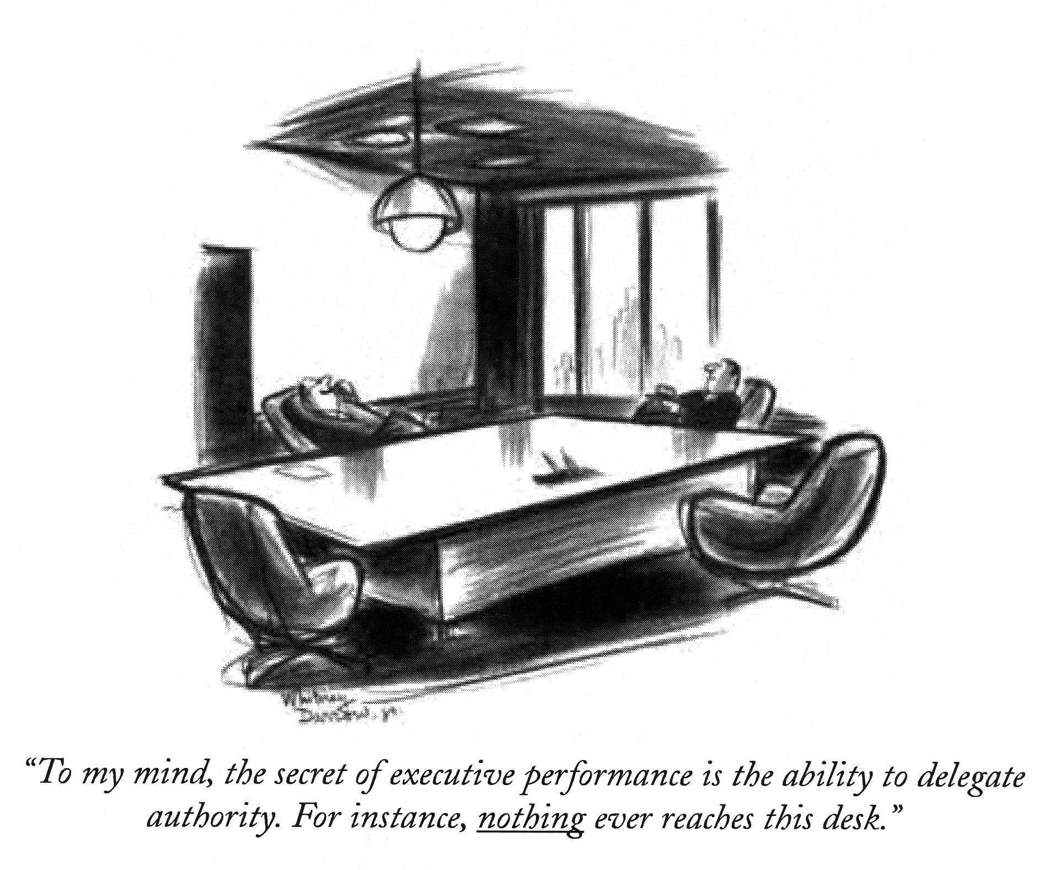
An example of an ability

Slide 18
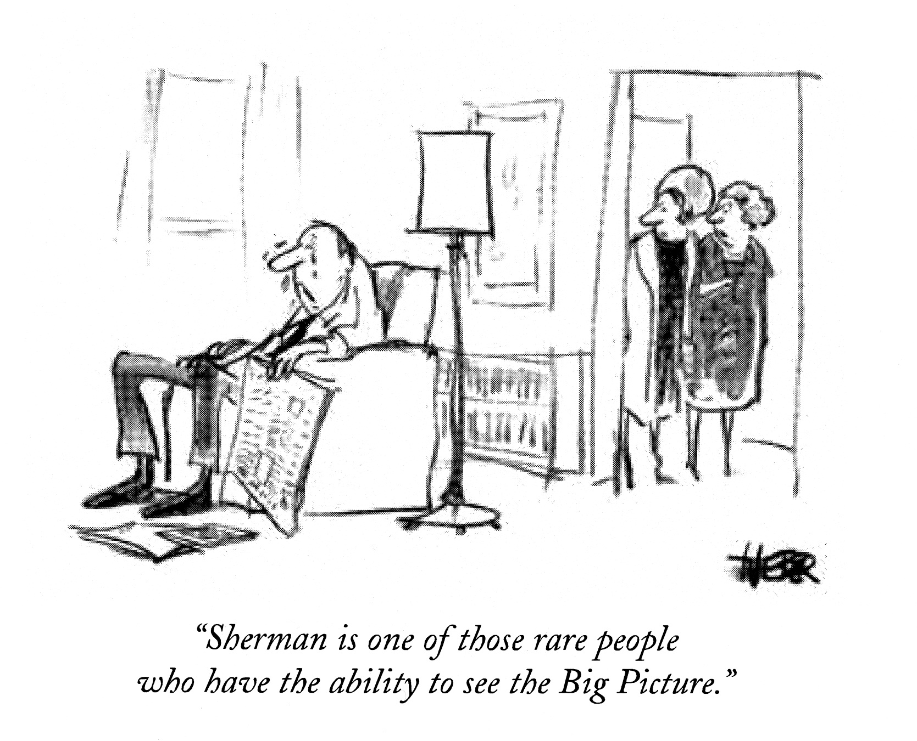
An example of an ability

Slide 19
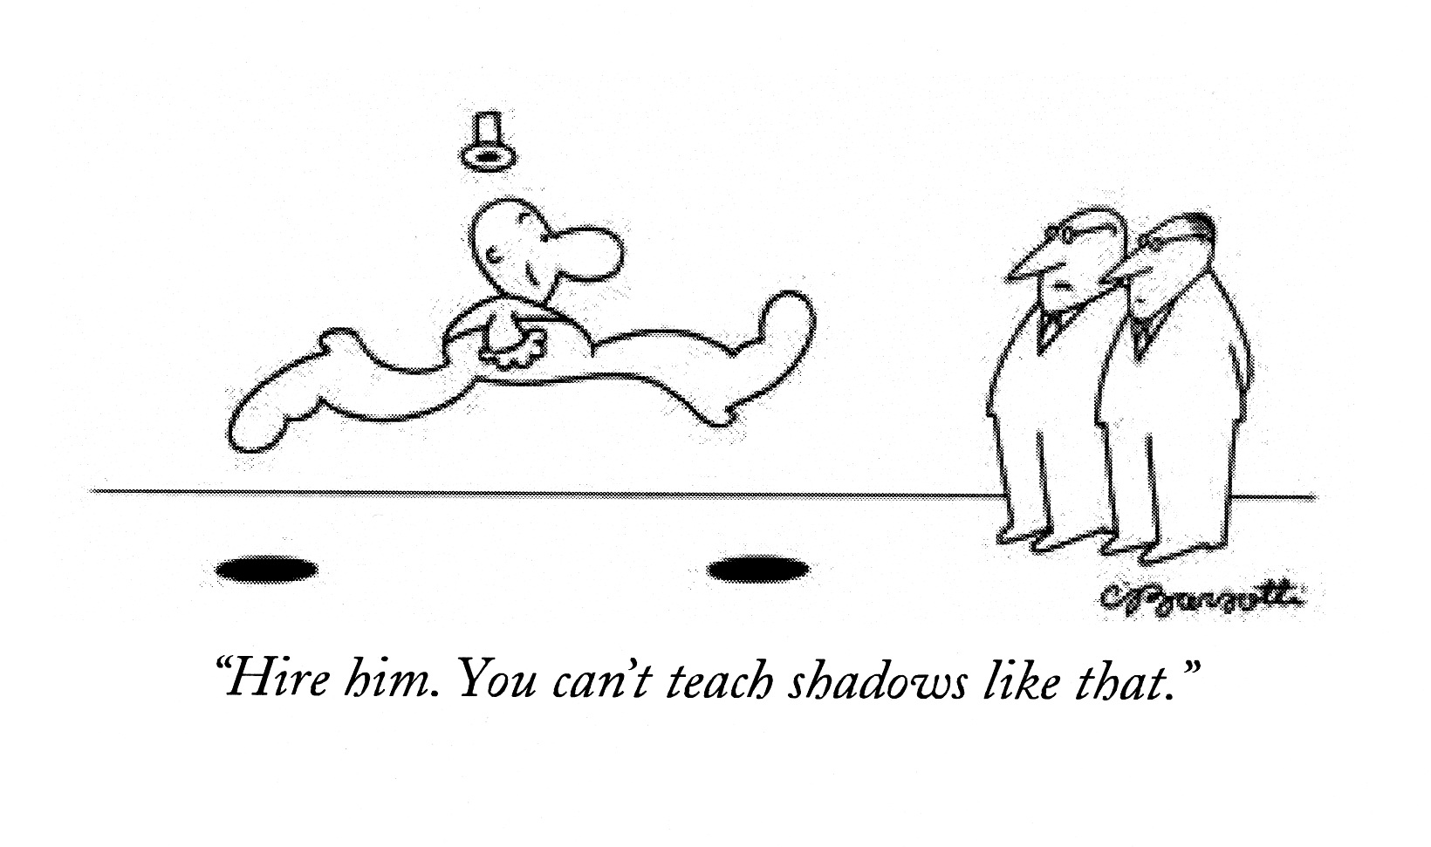
A natural gift

Slide 20
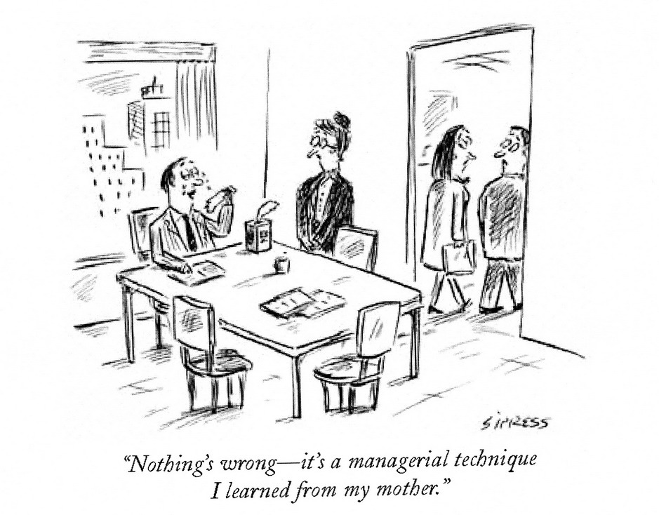
An example of a skill?

Slide 21
The ambiguity of “ability”
So: the three principal senses of “ability” (points on a continuum) we need to keep in mind.
Capacity
Ability
Skill

Slide 22
Why does all this matter?
Formal, quantitative, psi research is almost ridiculously premature.
Researchers have no idea what kind of organic function they’re trying to investigate—e.g., whether psychic functioning is a capacity, ability, or skill, and what its natural history is (its function outside the lab).

Slide 23
Why does all this matter?
Compare to:
Memory
We’re at least familiar with its everyday operations.
The ability to make people laugh
We’re familiar enough with it to know it can’t be adequately studied experimentally.
A tennis player’s ability to return serves
We can systematically and easily examine it in real-life, relevant situations.

Slide 24
Why does all this matter?
Obviously, different endowments must, as a rule, be studied in different ways—e.g.,
Mechanical aptitude
The ability to produce witty remarks
The ability to baby-sit
The ability to learn a new language
The ability to empathize
The skill of playing football goalkeeper
The capacity to blink
The capacity to dream

Slide 25
Some conspicuous features of athletic abilities (and skills):
(1) Not uniformly distributed among humans.
(2) People have them to varying degrees (e.g., good enough for college but not professional sports).
(3) They come in many sub-varieties (e.g., the ability to play tennis, football, golf).
(4) A person may have one sub-ability but not another (e.g., good at tennis, but not football; good at rings (in gymnastics) but not parallel bars.
(5) These specialties can be very specific or idiosyncratic (e.g., a very distinctive way of throwing a side-arm curve ball; the ability to play right guard but not left guard).

Slide 26
Similarly for musical abilities:
E.g.,
(1) Musicians usually can play some instruments but not others.
(2) They might be able to compose but not conduct (or vice versa)
(3) They might master certain idioms but not others (e.g., Baroque but not late Romantic; jazz and pop, but not classical; bebop but not swing or Dixieland).
(4) They might sing Verdi but not Bach or Rossini, or Mozart but not Wagner, Wolf, or Berio.
Similarly even for more specific musical abilities.

Slide 27
Composing Music
This ability (skill) can be expressed in many ways:
Many notate their compositions; others lack this ability.
Absolute pitch? Relative pitch? Neither?
Some compose directly onto paper; others need a piano or some other instrument.
Some work best with large forms; others don’t.
Some write especially well or idiomatically for certain instruments; others don’t.
Some have keen ability to set words to music; others don’t.
Some better at harmony, rhythm, instrumental color (these secondary abilities take different forms and manifest in different degrees and combinations).

Slide 28
Composing Music
SO: No reason to think that compositional ability or skill allows many useful generalizations. And, no reason to think this is unique to this example.
People who possess a general ability may exhibit it in various ways and to varying degrees.
It depends on which subsidiary abilities or skills they possess and the manner in which they possess them.
At our current level of ignorance, we’re in no position to say that psychic functioning is an exception to this rule.

Slide 29
Functioning Psychically
It looks as though the manifestation of psi is as deeply idiosyncratic and variable as any other ability.
Psi-conducive conditions may be as personal and individual as the conditions people find amusing, or erotic.
The subjective experience of exercising one’s psi varies widely (e.g., whether RV is accompanied by vivid, familiar—or any—imagery.)
The range and specificity of the ability also varies idiosyncratically (e.g., may be good at x but not y).

Slide 30
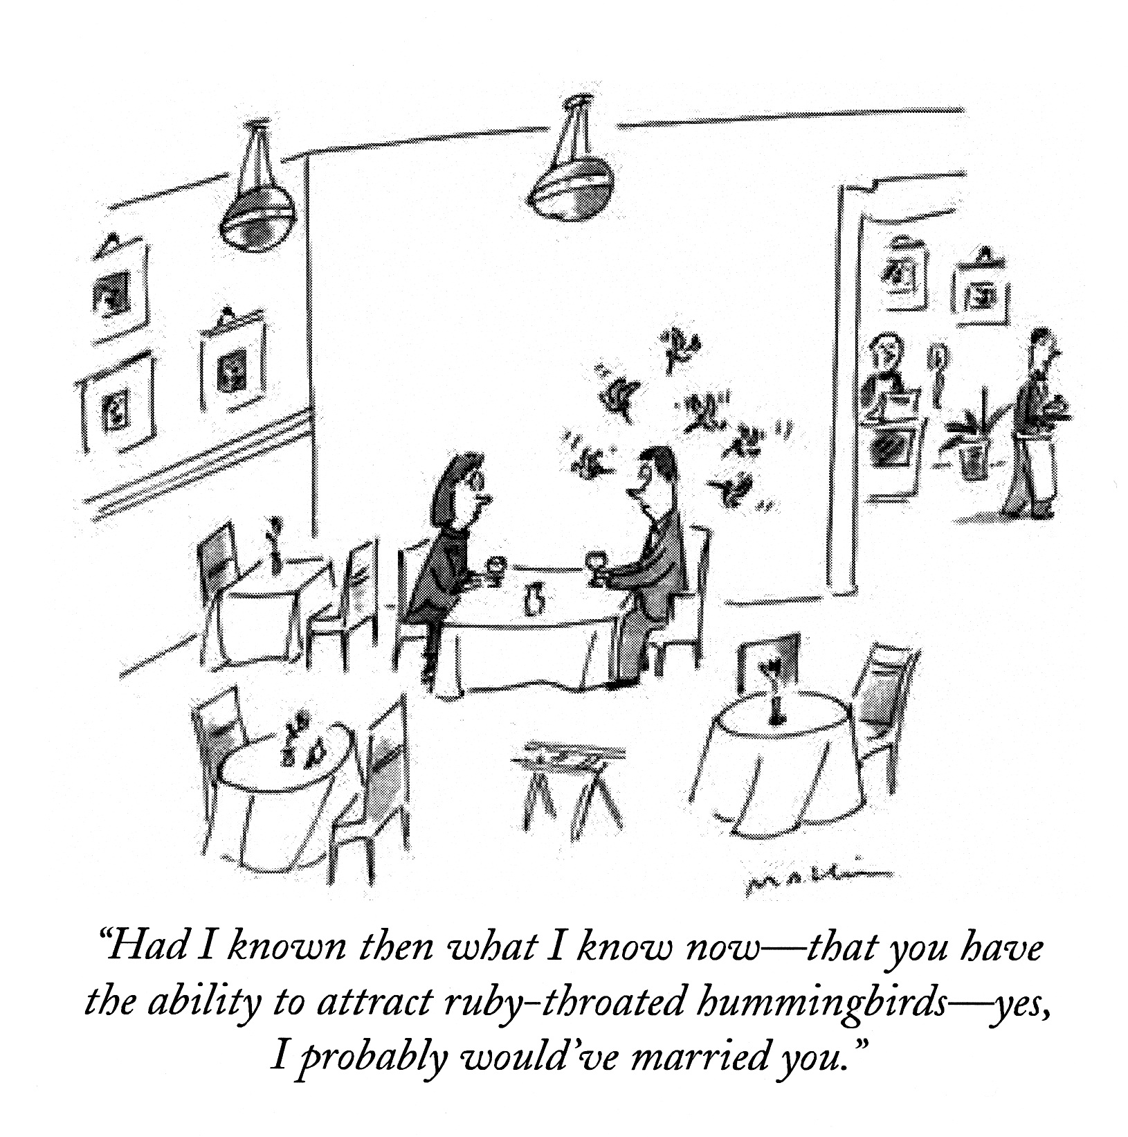
A very idiosyncratic ability

Slide 31
Moreover, many (most? all?) abilities are highly context-dependent and can be expressed or studied properly only under quite specific conditions:
E.g., we can evaluate a tennis player’s ability to return serves only under physically and psychologically challenging game conditions.
Similarly, a pianist’s ability to play the “Waldstein” Sonata, or a comedian’s ability to be funny, varies with confidence level, audience attitude, personal distractions, etc.

Slide 32
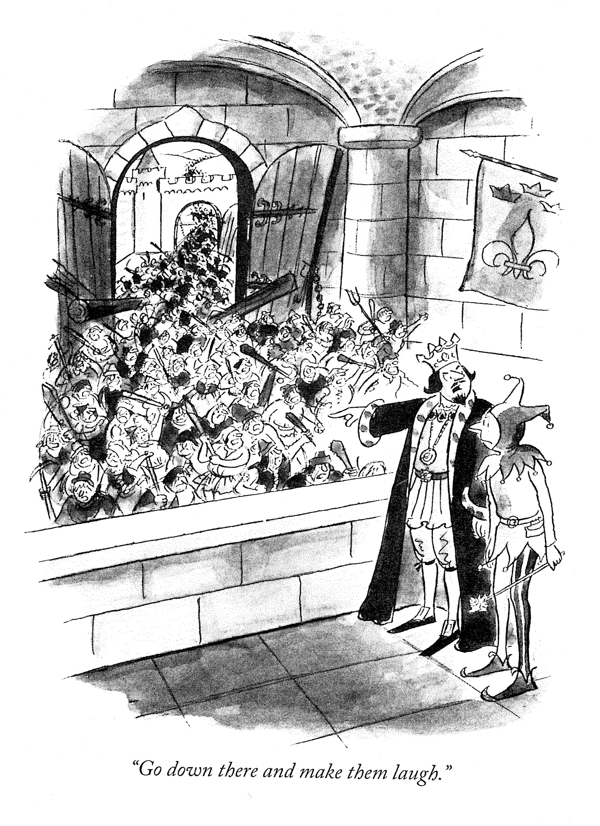
Context-dependency

Slide 33
SO: if psychic functioning is analogous to these sorts of organic endowments, then we could say:
(1) Not everyone is psychic.
(2) Some are more psychic than others.
(3) Not all psychics are psychic in the same way.
(4) These abilities are (highly?) situation sensitive.
(5) It would be appropriate to say that some people are psychically gifted.

Slide 34
But what if psychic functioning is analogous to a common or elementary capacity?
(1) It might be as uniformly distributed among humans as pulmonary or reproductive functioning, or as reflexive and involuntary as nursing behavior or fear responses.
(2) It might be robust in all but a few persons.
(3) It might be something we do all or much of the time, without conscious awareness or control (like our capacity to digest food).
(4) It would probably still be situation-sensitive.

Slide 35
In that case, a key question:
If psychic functioning is analogous to a common capacity or widespread ability, what distinguishes good subjects (e.g., successful RVers) from others?
Does research track only those who have the ability to demonstrate psi?
Is that ability a meta-ability—i.e., to function psychically in specific (and not necessarily all) test situations?

Slide 36
But if successful experiments merely track that meta-ability:
This provides no clue as to whether psychic functioning itself is a capacity or ability, common or uncommon.
Are successful subjects analogous to the yogi controlling breathing (a common human capacity)? Or the musical virtuoso or star athlete (displaying exquisite control over abilities only some enjoy)?

Slide 37
The Moral So Far:
So long as our goal is merely to establish that psychic functioning occurs, pragmatically it may matter little whether it’s a capacity or an ability, or common or uncommon.
Obviously unwise in any case to study randomly-selected subjects. E.g., this is not how to establish the reality of virtuosic mnemonic, calculating, or artistic abilities, or meta-abilities like that of the yogi, or familiar but highly situation-sensitive abilities.

Slide 38
More on situation-sensitivity
All these are situation-sensitive—and in fact can easily be enhanced or diminished:
The capacity to digest food, sleep, breathe deeply, ward off infections, get an erection.
The ability to make people laugh, write a philosophy essay exam, maintain a positive attitude, recite a poem from memory.
The skill of shooting free-throws, walking a tightrope, landing a jumbo jet.

Slide 39
More on situation-sensitivity
Reasonable assumption (until we have evidence to the contrary): psychic functioning is continuous in broad outline with more familiar human or organic endowments.
In that case: psychic functioning is likely to be situation-sensitive no matter whether it’s a capacity, ability, or skill.
You’re telepathic? So what am I thinking?

Slide 40
What if psi is need-determined?
If psi is related in a lawlike way to an agent’s real or perceived needs (e.g., for an organism’s survival):
It could be analogous to the capacity to increase adrenalin flow, or produce endorphins.
Or the ability to move or respond quickly, act decisively, or be courageous, or cheerful in the face of adversity, or selfless when a loved one needs to be protected.

Slide 41
What if psi is need-determined?
The development and exercise of skills: probably not need-determined. Generally, we have the option to develop and exercise a skill.
BUT: the ability to exercise some skills might bear a lawlike relation to real or perceived needs—e.g., the way some athletes perform optimally only under the pressure of a real game.

Slide 42
What if psi is need-determined?
SO: the view that psychic functioning is need-determined doesn’t favor interpreting it as a skill.
This too may suggest that “star” or “gifted” subjects are analogous to yogis or great athletes—i.e., either in harnessing conspicuously an organic endowment that’s relatively common, like the capacity to alter blood flow, or not so common, like the ability to return tennis serves or slam dunk in basketball.

Slide 43
What if psi is need-determined?
SO: It still would be appropriate to consider some individuals as psychically gifted.
“Gifted” in the sense of having unusual and exquisite—and probably conscious—control over capacities or abilities which others lack, or which they command more coarsely, or only involuntarily.

Slide 44
What if psi is need-determined?
It would highlight an inexcusable psychological and methodological superficiality
The crucial question which almost nobody asks: “Whose needs are best served by the occurrence of some ostensible psi effect?”
It’s clearly foolish to treat subjects and relevant others as mere potential emitters or recipients of psi (psychological stick figures).
But then we have almost no clue what’s happening or who is doing what in connection with many psi occurrences.

Slide 45
What if psi is need-determined?
That’s because (a) source of psi problem, and (b) we have no grounds for assuming that there are clear (or any) limits to the scope or refinement of psychic functioning.
E.g., In “precognitive” remote viewing: retrocausation, psi-mediated inference, telepathic influence, massive or thoroughgoing PK on subsequent events?
In PK tests with pre-recorded targets: retro-PK on target generation, or clockwise (experimenter) influence on subsequent events?

Slide 46
Relevance of Savants
Their abilities or skills are typically highly circumscribed and idiosyncratic.
Two sorts of limitations:
(1) Savants may be profoundly dysfunctional except for their musical, mathematical, artistic, or mnemonic abilities.
E.g., Spastic until playing piano.
E.g., Barely able to care for himself, but can repair virtually any mechanical device.

Slide 47
Relevance of Savants
Their abilities or skills are typically highly circumscribed and idiosyncratic.
Two sorts of limitations:
(2) Savants may be limited within their special area of expertise.
E.g., Calendar savants are accurate only within clear ranges of years (different ranges for different savants).
George and Charles could factor any number, but couldn’t count to 30.

Slide 48
Relevance of Savants
The lesson from this:
Everybody’s abilities are idiosyncratically circumscribed to some extent—both as compared to their other abilities and also within their areas of specialization.
But savants remind us vividly that a subject good at one task may not be good at what we (or skeptics) think is a related task.

Slide 49
All-Purpose Psi Argument
If a subject has psi ability A he should have psi ability B. And since he’s unable to demonstrate B it’s unreasonable to claim that he possesses A.
E.g., if S can levitate a table, why not control a roulette wheel or heal the sick?
Or if S can accurately describe remote military targets, why not diagnose a disease, or score well on a computerized ESP test?

Slide 50
All-Purpose Psi Argument
That’s clearly as stupid as insisting that someone who can play the flute should also be able to play the trombone.
Or that a person good at pole vaulting should also be good at tennis or basketball.
Or that a gifted surgeon should also be able to repair cars, or fix a broken watch.

Slide 51
All-Purpose Psi Argument
It take only a minimum of humility and common sense to admit that we have no idea how (or if) having a certain psychic ability affects the probability of having another.
Despite our current level of ignorance, it’s reasonable to expect psi to be as variable and individualistic as every other human ability.

Slide 52
So where are we?
Even if anyone can, with practice, exhibit psi functioning, this tells us relatively little.
It wouldn’t show that psi functioning is evenly distributed among humans, and
It doesn’t clarify what star or gifted subjects are (like yogis, or like great athletes?)—thus, whether psi is a capacity or ability.
It doesn’t clarify whether the real psychic virtuosi are those who operate more covertly and unconsciously (e.g., unlucky people).

Slide 53
So where are we?
If psychic functioning is an ability, or if there is a skill associated with displaying psi consistently, we must be careful not to over-simplify our description of the situation, or lapse too easily into generalizations about what psi is, how one should go about it, etc.
Our ignorance about the nature of psi is still considerable, and in part it’s because we still have no firm grasp of its role in everyday life.

Slide 54
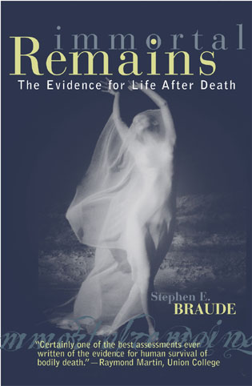

Slide 56
JazzPhilosopher.com

Slide 57
Time for Discussion

